Slide 1


Slide 1
LINKEDIN PROFILE ANALYSIS
-from January to November 2024-

Slide 2
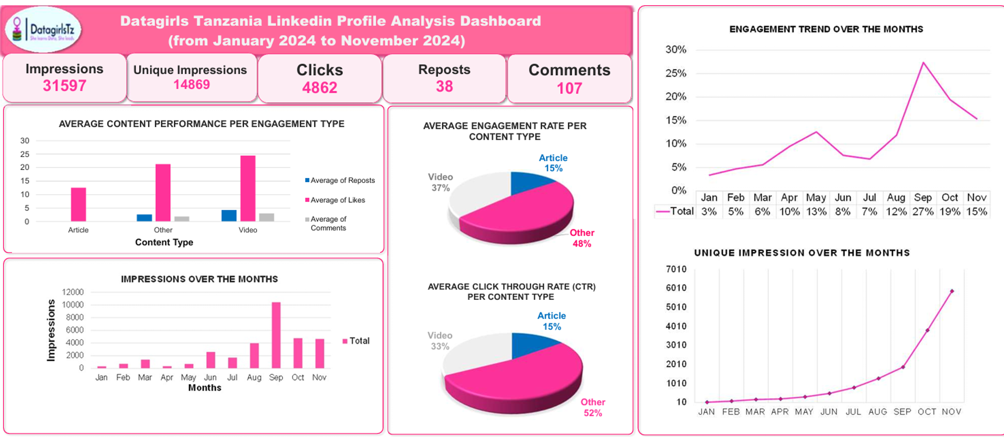
dashboard

Slide 3
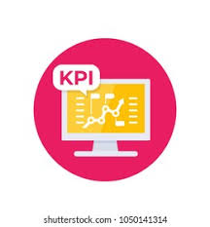




Key performance indicators
31597 Impressions
4862 Clicks
107 Comments
38 Reposts

Slide 4

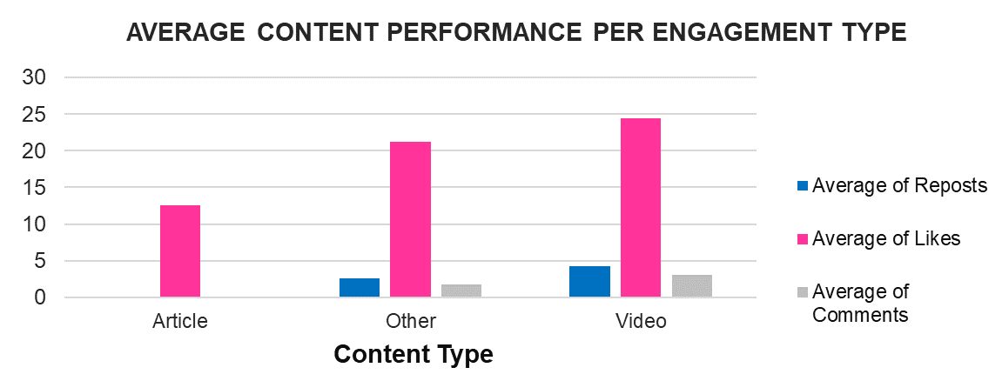
Content performance
“Other” content type led in impressions, reposts, and engagement rate (48%), making it the most impactful category for visibility.
Videos were highly interactive, generating the most likes and comments, indicating they resonate deeply with the audience.

Slide 5
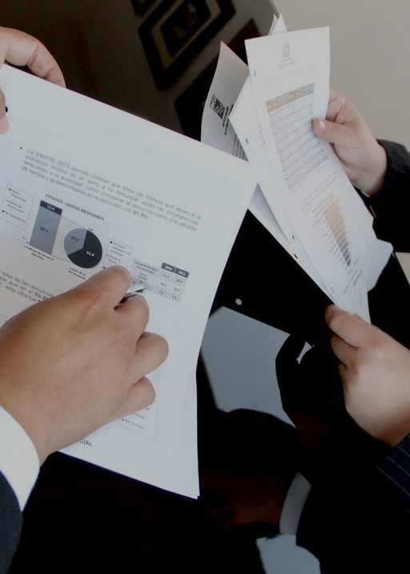
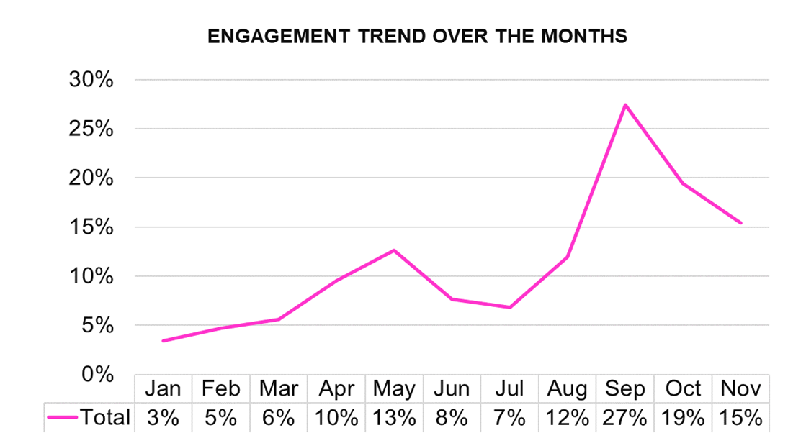
Slide 6
ENGAGEMENT TRENDS
Engagement rates peaked in September, suggesting seasonal or strategic factors contributed to a strong performance.

Slide 6
OTHER INSIGHTS
High impressions did not always correlate with high interactions, highlighting the need to pair visibility with engaging content.
Audience growth aligns with months of high engagement, emphasizing the importance of leveraging momentum to build the community

Slide 7
RECOMMENDATIONS
Upcoming Deposits
Encourage interactivity and audience growth
$704.78
Prioritize High-Engagement Content Types
Enhance content consistency and variety
Prioritize video content and optimize “Other” content types to maximize engagement, leveraging compelling visuals and storytelling to captivate their audience.
$191.01
Use interactive features like polls, Q&A sessions, and tag campaigns.
Collaborate with influential voices in tech and highlight inspiring success stories to attract sponsors and expand the community.
Maintain a consistent posting schedule with a mix of educational content, success stories, and community highlights
$189.31
$186.54

Slide 8

Slide 10
THANK YOU

